Slide 1

League of Legends
How to play and what do champs do

Slide 2
Index

Slide 3
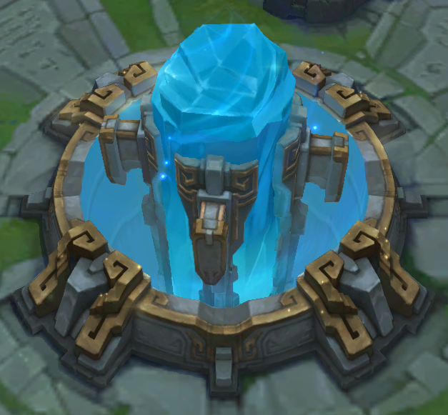
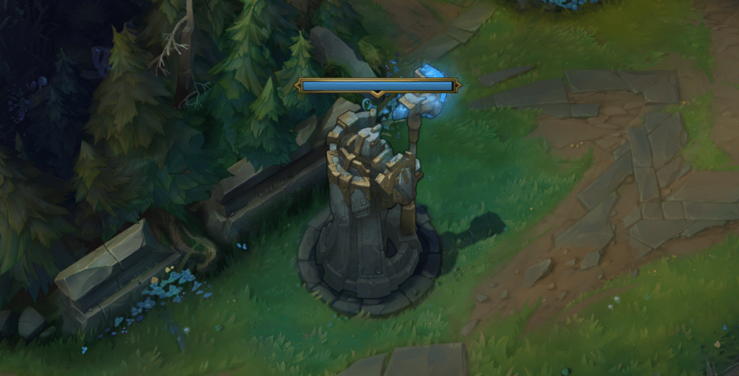
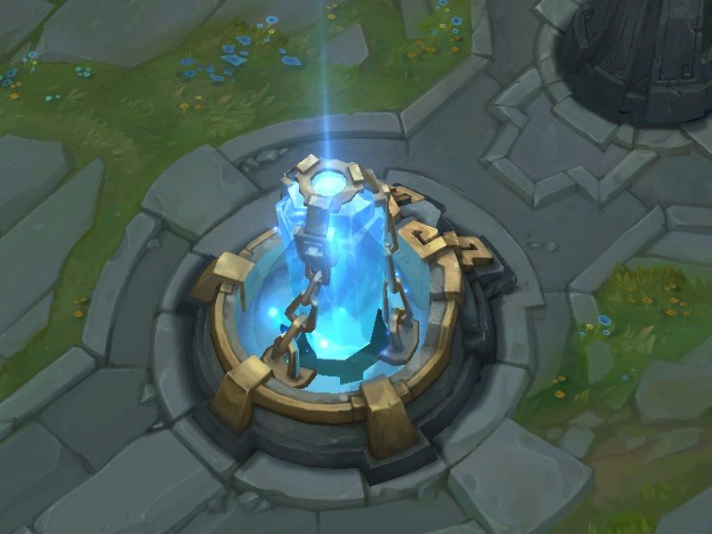
How to play
The purpose of the game is just to destroy the nexus.
To do so you first got to destroy the towers and inihibitors.
Nexus
Tower
Inihibitor

Slide 4
How to play
Movement is up to you Either Right Click or WASD

Slide 5
Champions
There’s 173 champions.
They have all a passive
Hwei has 11 abilities, Gnar has 7 abilities and Aphelios has 2 abilities
Everyone else has 4 abilities.

